Slide 1

SPAM DETECTION USING MACHINE LEARNING
SUBMITTED TO:
Mr. ROHAN PILLAI
SUBMITTED BY :
HIMANSHU JHARWAL 2K20/EE/125
ARNAV ARORA 2K20/EE/54
DEEPAK TIWARI 2K20/EE/88

Slide 2
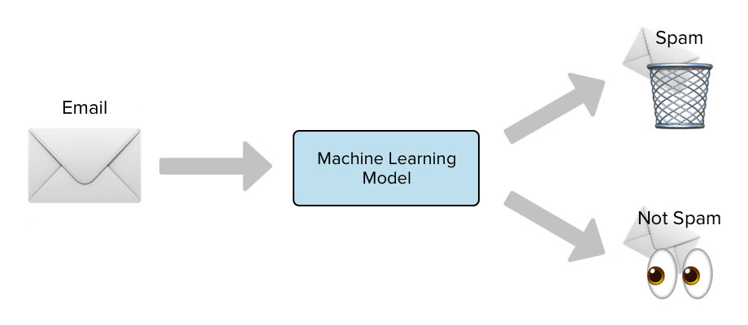
SPAM DETECTION
A software routine that deletes incoming spam or diverts it to a "junk" mailbox (see spam folder). Also called "spam blockers," spam filters are built into a user's email program. They are also built into or added onto a mail server, in which case the spam never reaches the user's mailbox. See spam, email program and mail server.
Spam filtering can be configured to trap messages based on a variety of criteria, including sender's email address, specific words in the subject or message body or by the type of attachment that accompanies the message.

Slide 3
MAIL DATA
LOGISTIC REGRESSION MODEL
DATA PRE-PROCESSING
TRAIN-TEST SPLIT
New MAIL
LOGISTIC REGRESSION MODEL
PREDICTION - SPAM OR HAM

Slide 4
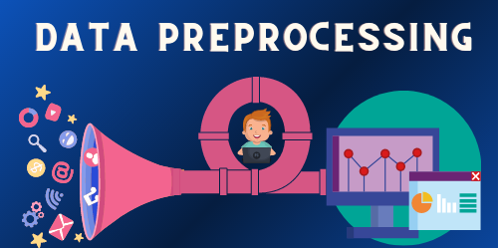
DATA PRE-PROCESSING
A software routine that deletes incoming spam or diverts it to a "junk" mailbox (see spam folder). Also called "spam blockers," spam filters are built into a user's email program. They are also built into or added onto a mail server, in which case the spam never reaches the user's mailbox. See spam, email program and mail server.
Spam filtering can be configured to trap messages based on a variety of criteria, including sender's email address, specific words in the subject or message body or by the type of attachment that accompanies the message.

Slide 5
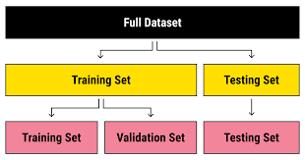
TEST-TRAIN SPLIT
The train-test split procedure is used to estimate the performance of machine learning algorithms when they are used to make predictions on data not used to train the model.
It is a fast and easy procedure to perform, the results of which allow you to compare the performance of machine learning algorithms for your predictive modelling problem. Although simple to use and interpret, there are times when the procedure should not be used, such as when you have a small dataset and situations where additional configuration is required, such as when it is used for classification and the dataset is not balanced.

Slide 6
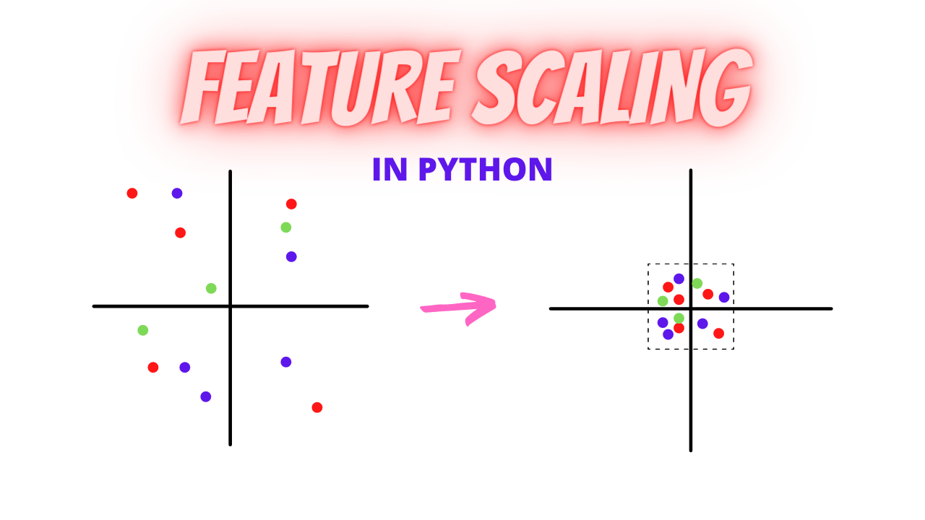
FEATURE SCALING
Feature Scaling is a technique to standardize the independent features present in the data in a fixed range. It is performed during the data pre-processing to handle highly varying magnitudes or values or units. If feature scaling is not done, then a machine learning algorithm tends to weigh greater values, higher and consider smaller values as the lower values, regardless of the unit of the values.

Slide 7
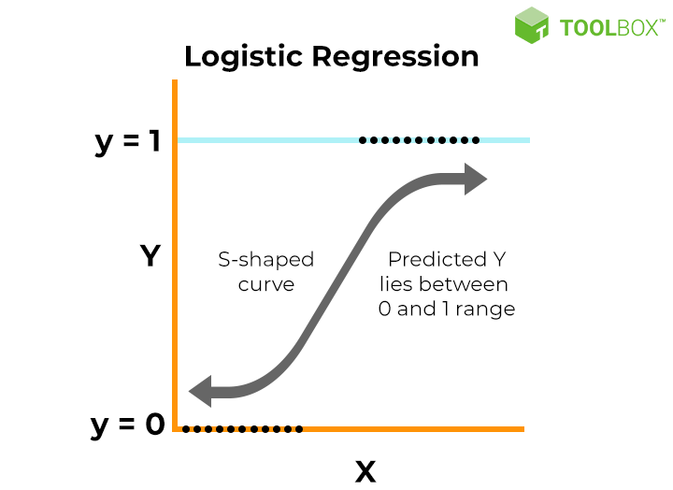
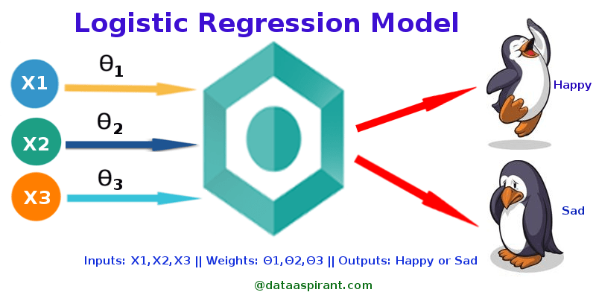
LOGISTIC REGRESSION MODEL
Logistic regression is one of the most popular Machine Learning algorithms, which comes under the Supervised Learning technique. It is used for predicting the categorical dependent variable using a given set of independent variables.
Logistic regression predicts the output of a categorical dependent variable. Therefore the outcome must be a categorical or discrete value. It can be either Yes or No, 0 or 1, true or False, etc. but instead of giving the exact value as 0 and 1, it gives the probabilistic values which lie between 0 and 1.
Logistic Regression is much similar to the Linear Regression except that how they are used. Linear Regression is used for solving Regression problems, whereas Logistic regression is used for solving the classification problems.
In Logistic regression, instead of fitting a regression line, we fit an "S" shaped logistic function, which predicts two maximum values (0 or 1).
Logistic Regression is a significant machine learning algorithm because it has the ability to provide probabilities and classify new data using continuous and discrete datasets.
Logistic Regression can be used to classify the observations using different types of data and can easily determine the most effective variables used for the classification. The below image is showing the logistic function:

Slide 8
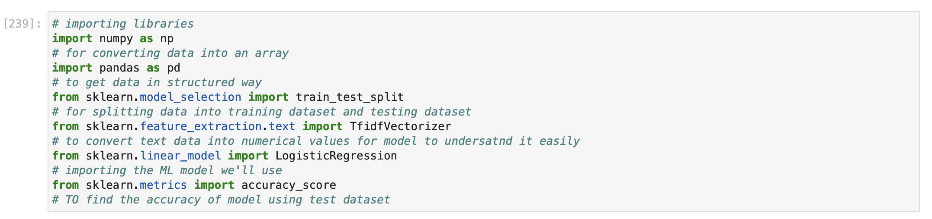
Code and Implementation
IMPORTING REQUIRED LIBRARIES

Slide 9
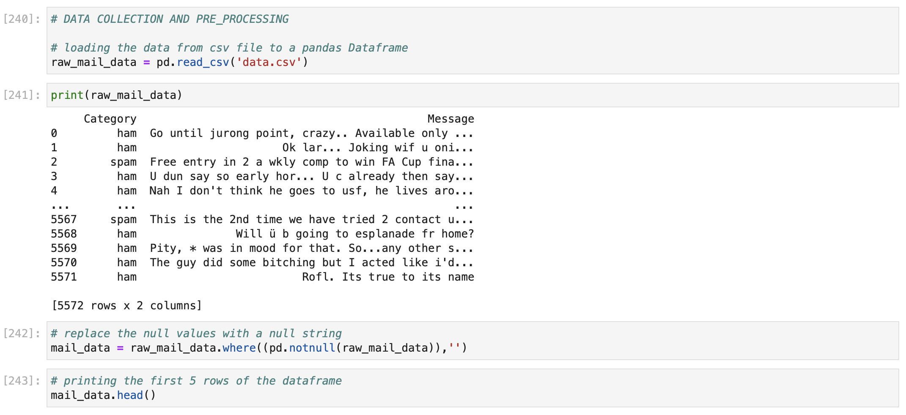
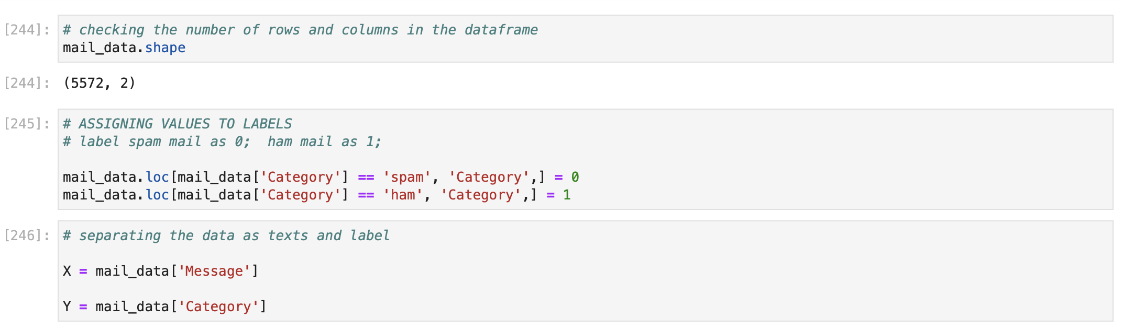
DATA COLLECTION AND PRE-PROCESSING

Slide 10
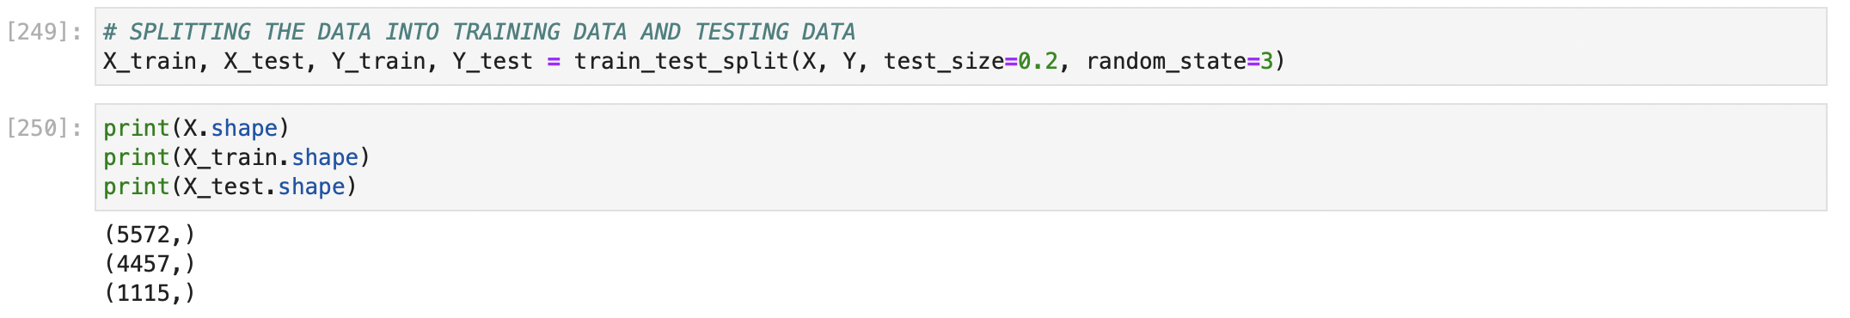
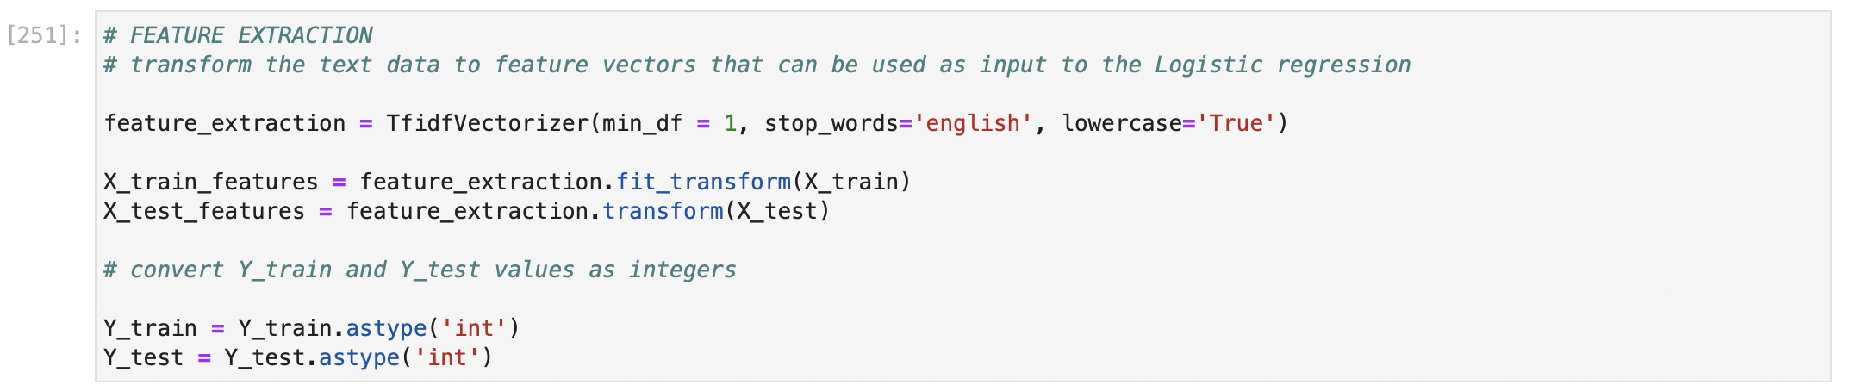
TEST-TRAIN SPLIT
FEATURE EXTRACTION

Slide 11
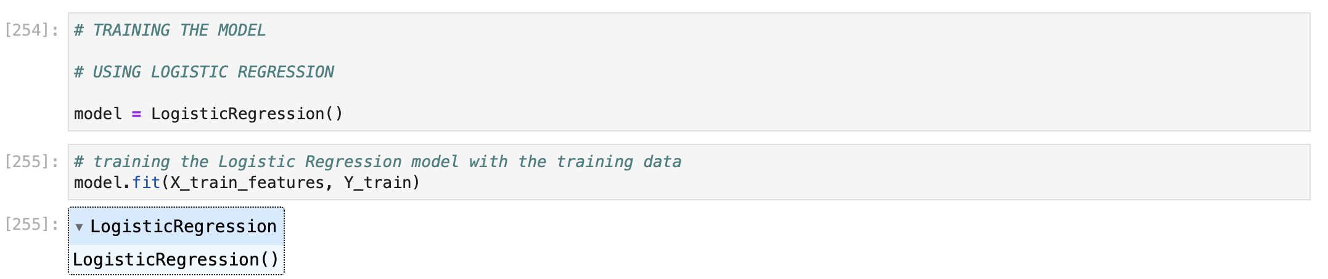
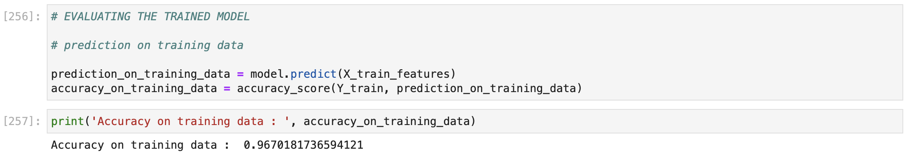
TRAINING THE MODEL
CHECKING ACCURACY OF THE MODEL

Slide 12
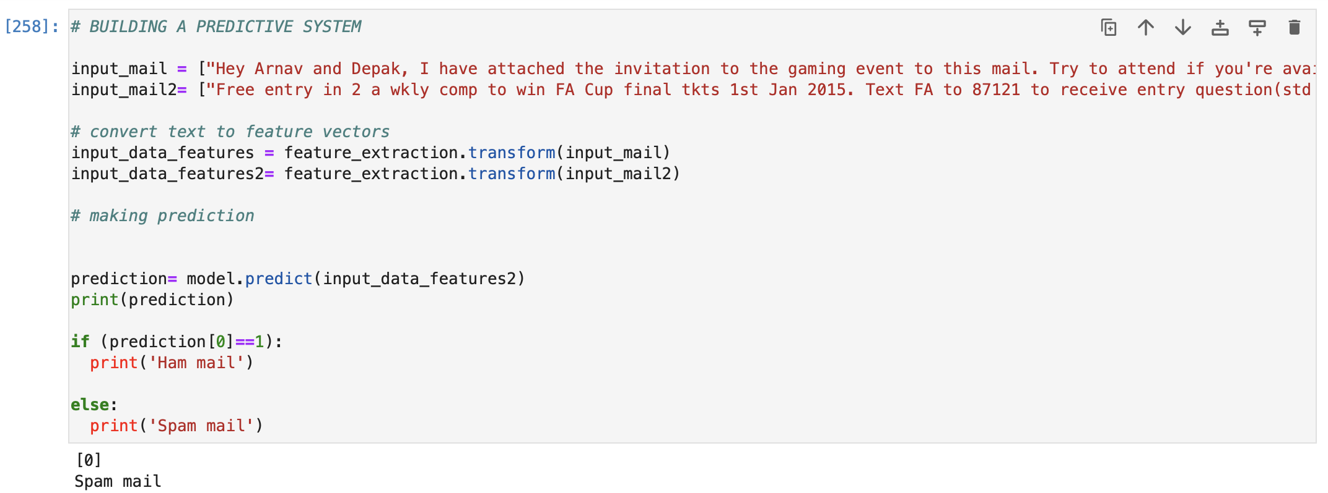
BUILDING PREDICTIVE SYSTEM

Slide 13

This Photo by Unknown Author is licensed under CC BY-SA-NC

